Slide 1
MLA 8th Edition
A quick overview

Slide 2
The MLA core elements are as follows:
Author | Number
Title of source (Book, “Article”) | Publisher
Title of container (Mag, Journal, Newspaper, web site, etc…) | Publication date
Other contributors (editors, translators, chapter authors) | Location
Version

Slide 3
books
Eighth edition
Jacobs, Alan. The Pleasures of Reading in an Age of Distraction. Oxford UP, 2011.
In this version, only the most essential information is included (author’s name, book title, publisher, and date). Note that the city of publication is not needed, and the medium of publication is eliminated.

Slide 4
Article in a Journal
Kincaid, Jamaica. “In History.” Callaloo, vol. 24, no. 2, Spring 2001, pp. 620-26.
Also note that punctuation is simple; only commas separate the journal title, volume, number, date, and page numbers.

Slide 5
Important Note on the Use of URLs in MLA
MLA no longer requires the use of URLs in MLA citations. Because Web addresses are not static (i.e., they change often) and because documents sometimes appear in multiple places on the Web (e.g., on multiple databases), MLA explains that most readers can find electronic sources via title or author searches in Internet Search Engines.
IBO MANDATES URL/DOI AND ACCESS DATE!
For instructors who still wish to require the use of URLs, MLA suggests that the URL appear starting with www. Break URLs only after slashes. Add Accessed date.
Aristotle. Poetics. Trans. S. H. Butcher. The Internet Classics Archive. Atomic and Massachusetts Institute of Technology, 13 Sept. 2007. www.classics.mit.edu/. Accessed 5 Apr. 2017.

Slide 6
No page number: use URL
Works Cited:
Online periodical where page numbers are not given | “The Time is Now.” Persuasions, vol. 35, no. 1, 2014, www.persuasionpsychol.com, Accessed 12 May 12, 2014. Simply omit page numbers and add the URL and Access date after the publication date.

Slide 7
Links to other examples – owl Purdue
MLA Works Cited: Electronic Sources (Web Publications)
MLA Works Cited: Other Common Sources
MLA documentation for tables, figures, and examples
Captions: images and citations

Slide 8
In-text Citation
Use parenthetical in-text citation (Smith 42)
Only if instructor instructs you use of footnotes is fine
for source reference – not for additional information or definitions
Similar to works cited information BUT with slight changes

Slide 9
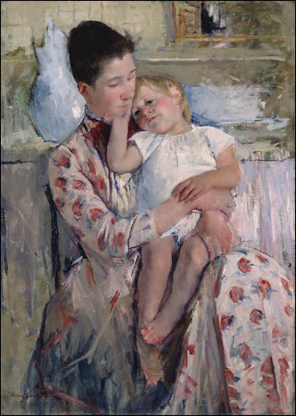
Captions to Images, and Photos of Artwork
When citing an image, the caption should be labeled as Figure (usually abbreviated Fig.), assigned an Arabic numeral, and given a title or caption.
For photos of artwork, include the book's publication information of the text in which the image appears.
A label and title or caption ordinarily appear directly below the illustration and have the same one-inch margins as the text of the paper.
Captions should be numbered consecutively
Fig. 1. Mary Cassatt, Mother and Child, Wichita Art Museum. Illus. in Novelene Ross, Toward an American Identity: Selections from the Wichita Art Museum Collection of American Art (Wichita, Kansas: Wichita Art Museum, 1997) 107.

Slide 10
Works Cited
"Images: Captions and Citations." Rhode Island School of Design. Rhode Island School of Design, 8 Dec. 2015, www.risd.libguides.com/citingimages. Accessed 9 May 2016.
Laguna College of Art and Design. Laguna College of Art and Design, 2013, www.google.com/, Accessed 9 May 2016.
Purdue Online Writing Lab. Purdue University, 2016, www.owl.english.purdue.edu/, Accessed 9 May 2016.

