Slide 1
Go get:
Your old PT10 folder
  Alpha order around the room
1 Student EE guide packet
  Metal book holder
1 Topic of Interest Handout
  Metal book holder
1 UAIS Timeline handout
  Metal book holder

Slide 2

The Extended Essay
Student Training Workshop:
September 23,
October 14 and 15
Utica Academy for International Studies

Slide 3
Overall Student Presentation
Day 1 goals: Review matrix points; UAIS timeline; nature of the EE and its components; writing the EE; overall subject availability; academic honesty
Day 2: Managebac and UAIS Research Site Specifics; roles and responsibilities; examples of the Research and Reflection Space (RRS) and the Reflection on Planning and Progress form (RPPF); awareness of subject specific guidelines; topic brainstorming;
Day 3: General subject presentations by teachers; further background reading and becoming more familiar with subjects; potential time with content teachers might be present depending on his or her schedule

Slide 4

Let’s get started…
This Photo by Unknown Author is licensed under CC BY-SA-NC

Slide 5

The Diploma Programme
Notes:
Discuss the fit in the program; indicate page 31 learner profile-principled, open-minded; reflective

Slide 6
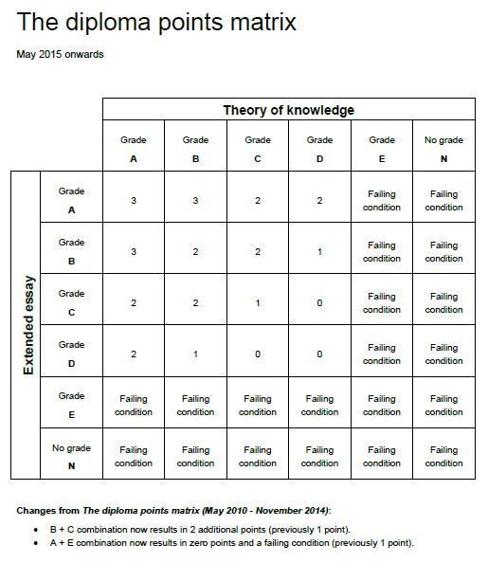

Slide 7
The UAIS EE Schedule
Provides internal & external due dates as the IBO strongly recommends
Builds in five mandatory in-school meetings with supervisors
3 include formal Reflections on planning and progress form time allotment
Assignments are given at each meeting and expected to be completed by the student before the next
Vast majority of work completed before senior year

Slide 8
Extended Essay at a glance
(T4 pages 35, 37-38)
Ignore world studies, interdisciplinary options, anthropology and anything mentioning ATL
Required for IB diploma eligibility
Externally assessed by IBO evaluators
Roughly 3,500-4,000 words in length
Required reflection not to exceed 500 words
Chosen from current subjects and preferably a current focus of study
Total assessment points 0-34, of which a grade between an A to E is awarded
Represents approximately 50 hours of work (could be more)
Topic agreed upon with supervisor
Notes:
T4 pages 35, 37-39; quick read 40-41; T4 42; then go over slides – ask for clarifications afterward

Slide 9
Nature of Extended Essay (cont.)
Involves collegiate, critical research
EE demands a “diverse range of sources”
Apply analytical and evaluative skills, terminology toward subject matter
Reflect on insights gained, evaluate decisions, and respond to challenges encountered in process
Concludes with the viva voce interview Nov–Dec 2020
Supervisor meetings totaling 5 hours maximum
Supervisor submits a predicted grade and a supervisor’s report to the IBO

Slide 10
Aims/Assessment Objectives (read bottom of page 38 – 39)
Plan carefully, leading up to proposed topic
Develop a thoughtful research question – MUST be a question
Gather, interpret, present, and argue information as it pertains to subject area
Use the correct vocabulary and argumentative style according to the demands of the subject
Apply analytical and evaluative skills in the subject chosen – this is NOT narrative or summarizing

Slide 11

Writing the Extended Essay
(T4 page 78-90)
Extremely precise structure
Introduction should be written after body
Main focus of essay is the body (12 points)
Sub-headings helpful in most subjects
Include only relevant sources, citations all present and consistent
Evaluator not required to read appendix

Slide 12
Where Can UAIS Students Write Their EEs?
IB enrolled Subject-Specific Areas
Group 1 (English) HL or SL
Group 2 (Spanish, French, Japanese)* HL or SL
Group 3 (History or Psychology) if taking HL or SL
Group 4 (Biology, Chemistry, Physics)* HL or SL
Group 5 (Math)* HL or SL – no Studies SL
Group 6 (Theatre, Visual Arts, Music) – no elective
Subject and topic specifics will be addressed later in training…
*These subjects require teacher approval for student selection.

Slide 13

See you October 14 and 15
This Photo by Unknown Author is licensed under CC BY-NC-ND

Slide 14
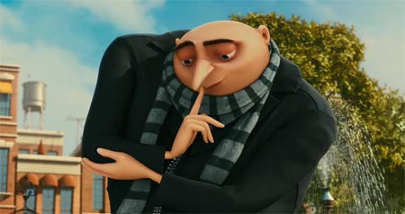
Day 2: Websites; RRS/RPPF; Subjects Guidelines
This Photo by Unknown Author is licensed under CC BY-ND

Slide 15
Off the Record from the IBO
Do not choose a subject that you are just beginning to have background in. This is not the time for beginner’s exploration. This is a time for further exploration.
Consider what is in the IB subject curriculum and go further.
Reports on other scientific reports in sciences vary in scoring. Experimental designs tend to be viewed as more unique but are not guaranteed for a higher score.

Slide 16
Off the Record from the IBO
Quality is important, but so is quantity. Getting as close to the 4,000 word-count is important…
…except in math. A great paper can be 3,300 words. But usually, 3,300 words will earn very low marks.

Slide 17
On the Record, From the IBO…
To qualify as a history EE, all events discussed must take place ten years ago or more
Group 2 EEs must be researched and written in the language for which it is being submitted and must meet current teacher approval
Japanese: 1 word = approximately 2 Japanese characters

Slide 18
On the Record, From the IBO…
Students MAY NOT elaborate, overlap with, or supplement an internal assessment (IA) from a DYP class with their EE choice (double dipping)
No two students may write an EE posing the same or nearly same question

Slide 19
Overlap of the EE and IAs
The IBO student handbook indicates that any strategic move on the part of a student that gives that student a “unfair advantage over another student,” which includes the use of one’s IA on the EE or vice versa, will result in a case of academic misconduct. Students will NOT write on the same topics as for the EE as an IA in that subject.

Slide 20

Referencing (pages 70-71)
Bibliography: collection of references
References: individual sources
Citations: In-text parenthetical and Footnoting documentation
  APA – no footnotes; all in-text + Reference page
  CMS – footnotes + Bibliography page
  MLA – Parenthetical or footnote* + Works Cited page
*as determined by supervisor

Slide 21
Be careful and detailed or…
…results in this: Not Submitted
“If a candidate uses the work or ideas of another person, the candidate must acknowledge the source using a standard style of referencing in a consistent manner. A candidate’s failure to acknowledge a source will be investigated by the IB as a potential breach of regulations that may result in a penalty imposed by the IB final awards committee” (First Examinations 2018).

Slide 22

School Responsibilities
Train all supervisors and students
Provide students with qualified supervisor
Make general and subject-specific information and guidelines accessible
Make students aware of how the EE fits into program requirements
Provide recommended deadlines to all supervisors and students
Provide learning and researching opportunities
Resolve all pending EE issues and questions
Provide means for EEs for e-upload for external assessing

Slide 23
Supervisor’s Role (read pages 48-50)
Use knowledge in subject area to provide advice and guidance to students
Helps define research question
Advises in the research process
Reads and comments on quality draft 1 time only
Submits a predicted grade to the IBO
Conducts the viva voce with student
Reports plagiarism or other academic misconduct if suspected

Slide 24
Responsibilities of the Student (pages 50 – 51)
Choose a topic of interest and invest the time into your research question
Observe and follow all EE regulations, both general and specific
Develop and maintain a Researcher’s reflection space (RRS)
Meet UAIS and supervisor deadlines
Communicate with your supervisor and EE coordinator!
  Attend meetings with RRS
  Ask for help
  Address emerging issues
  Be honest and open!

Slide 25
UAIS supervisors should…
(pages 48-50)
Spend 3-5 hours overall with you (not each meeting)
Advise to ensure you’ve written a solid research question
Advise you on where to find materials
Aid in verifying your sources
Help troubleshoot when you are stuck
Evaluate your quality draft and discuss it at a conference (senior year)
Conduct a viva voce conference at end (Jan. 2020)

Slide 26
UAIS supervisors DO NOT…
Do research for you
Tell you what sources to use
Give specific advice on how to improve your draft
Correct bibliographies or citations
Chase you down for meetings (intervention levels)
Re-teach you concepts in the subject matter you should already know

Slide 27

EE: The Iceberg Model
7/8 = Research Phase (Now-June 2020)
Student & supervisor work together to:
Explore and discuss ideas (student driven)
Locate appropriate resources (student driven)
Discuss readings and ideas (student driven)
Develop a suitable research question (student driven)
Supervisor monitors research progress
1/8 = Writing Phase (June 2020 -Nov. 2020)
Student works independently over summer to:
Write EE draft
Organizing your writing
Revision conference drives final draft of essay
Prepare the final EE

Slide 28
Managebac and
UAIS Research Site
Managebac
EE tab
Overall communication
Me
Supervisor
RRS v RPPF purposes
UAIS Research
Resources
Handouts

Slide 29

The UAIS Research Website
uaisresearch.com
Contains everything you will need:
  Rubrics for your subject area
  Step-by-step researching techniques/handouts
  Links to formatting guides (MLA, APA, Chicago)
  Advice from IBO evaluators
  EE examples in your subject area

Slide 30
The Researcher’s Reflection Space (RRS)
The RRS is a personal learning environment that can be either a physical or virtual support tool.
A space in which students are able to record reflections on what they are reading, writing and thinking.
It supports learning, thinking, critical analysis and evaluation and contributes not only to the development of a successful extended essay but also to skills and competencies for pathways beyond the Diploma Programme.
It can be used to:
  Record reflections;
  Respond to artifacts, such as photos, newspaper clippings, etc…
  Respond to prompts and questions that may arise in the students’ subject areas;
  Make connections to TOK classes or other aspects of the DP;
  Create Mind Maps®;
  Record emerging questions

Slide 31
Mind Map

Slide 32
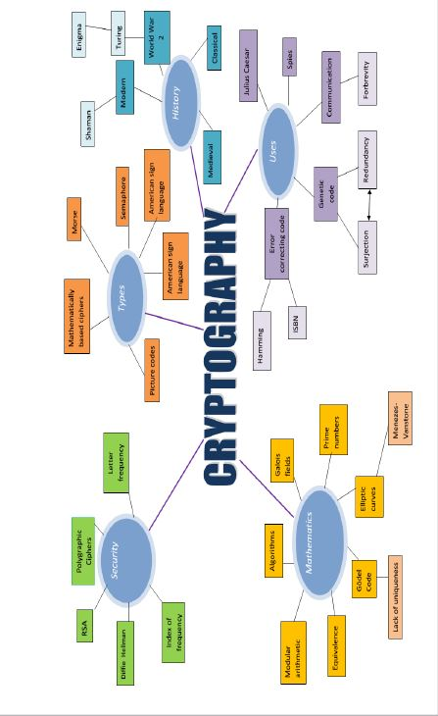

Slide 33
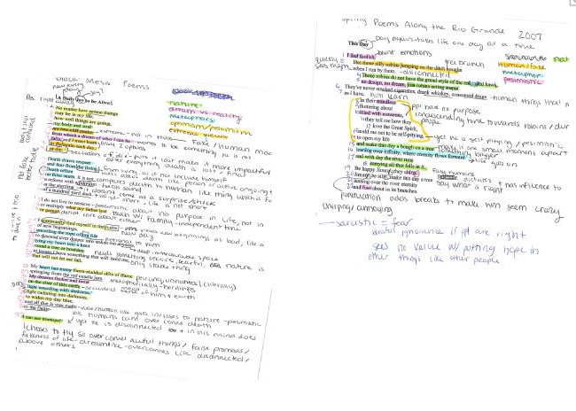

Slide 34
Journaling

Slide 35
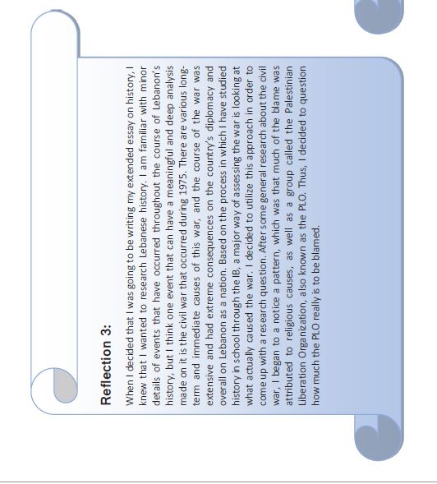
informal reflection

Slide 36

Video

Slide 37
It could also be:
T4
Sketching
Photographs
Post-it notes
Recordings
Charts
Graphs
Other??

Slide 38
Housing the RSS:
One Note, Google Drive, etc.
Uploading to MB similar to CAS
Notebooks
Sketchbook
Folder
Combination of above

Slide 39
The RRS and Supervisor Conferences:
The student should…
go prepared with issues to discuss – share excerpts from Researcher’s Reflection Space
reflect on previous discussions and be prepared to show how you have progressed
not expect the supervisor to do student’s thinking for the student
use the supervisor as a sounding board for ideas and arguments

Slide 40
Reflection in the core:
(Page 40-41) ***remember…
Theory of knowledge- The emphasis in TOK is on CRITICAL reflection, characterized by reflecting on metacognition, evaluation, justification, arguments, claims and counter claims, underlying assumptions and different perspectives.
CAS- The emphasis in CAS is on AFFECTIVE reflection, characterized by reflecting on attitudes, feelings, values, principles, motivation, emotions and self-development.
Extended essay- The emphasis in the EE is on PROCESS reflection, characterized by reflecting on conceptual understandings, decision-making, engagement with data, the research process, time management, methodology, successes and challenges, and appropriate sources

Slide 41
The RRS and reflection sessions
Evidence from an RRS can be used to stimulate discussions in the conference and reflection sessions.
In the first reflection session this may include: initial topic exploration; possible sources and methods; preliminary research questions; and personal reactions to the research topic.
In the interim reflection session this may include: reactions to readings; a timeline; a possible argument outline; setbacks and strategies for dealing with them.
In the final reflection, the viva voce, this may include: new questions uncovered; what they have learned about the topic and their own learning; the significance of their research.
Notes:
Handout of student guiding questions for reflection

Slide 42
Reflection in the EE (RRS & RPPF)
(T4 Page 40-42)
Reflection during the planning, research and writing process
The emphasis in the EE is on PROCESS reflection, characterized by reflecting on:
  conceptual understandings,
  decision-making,
  engagement with data,
  the research process,
  time management,
  methodology,
  successes and challenges,
  appropriate sources.
Consider the effectiveness of his or her choices, to re-examine their ideas and decide whether changes are needed.

Slide 43
Mandatory reflection sessions
First reflection session
This session should take place once the student has undertaken some preliminary research.
By the end of this session students should begin to formulate a working research question.
Interim reflection session
This session should take place once the student has undertaken a significant amount of their research and have begun to formulate an argument in response to their research question.
By the end of this session both the student and supervisor should feel confident that there is a clear and refined RQ; a viable argument; sufficient sources; and a clear understanding of the writing process.
Final reflection session (Viva Voce)
This session should take place once the final version of the EE has been submitted.
It is a celebration of the completion of the essay and a reflection on what the student has learned from the process.
2nd meeting
Summer kick-off
May
Post
Viva Voce
Nov/Dec

Slide 44
Reflections: student
may not exceed 500 words total for student
needs to be more analytical and evaluative with little descriptive (no step-by-step)
effective reflection highlights the journey the student has taken to engage in the intellectual and personal process
All formal reflections will be done immediately after meeting with supervisor at school on MB
Final reflection will be done at viva voce completion
All reflections on MB may not be changed once posted
Notes:
Handout – RPPF; student samples

Slide 45
Reflection in the EE
(Page 42, 61-65, 67-69)
Reflection during the planning, research and writing process
The emphasis in the EE is on PROCESS reflection, characterized by reflecting on:
  conceptual understandings,
  decision-making,
  engagement with data,
  the research process,
  time management,
  methodology,
  successes and challenges,
  appropriate sources.
Consider the effectiveness of his or her choices, to re-examine their ideas and decide whether changes are needed.

Slide 46
Criterion E
Engagement:
This criterion assesses the student’s engagement with their research focus and the research process. It will be applied by the examiner at the end of the assessment of the essay, after considering the student’s Reflections on Planning and Progress Form.
6/34 marks
Notes:
Handout the Rubric for this portion of the EE

Slide 47
Score the Reflection
Individually rate each reflection
Discuss as table and come to majority vote
The reveal

Slide 48
Reflections: supervisor
Allot time at end of conference for student formal reflection
  Library
  With supervisor
  hallway
  NOT AT HOME or to be done at later time!
Need to read each student’s reflection in a timely manner

Slide 49

Now for the subject details…
This Photo by Unknown Author is licensed under CC BY-NC-ND

Slide 50
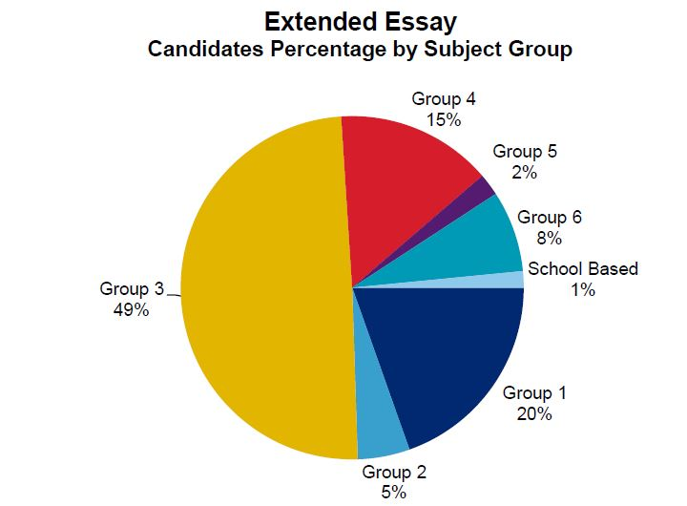

Slide 53
Subject Preference Seminars
October 15th, morning session (Groups 1, 3, 5)
Groups 2, 4, 6 during class time on or before October 25th
  Understand subject-specific guidelines in general
  Appropriate types of EE questions and samples of topics and questions
  Receive helpful examiner comments
  Academic referencing style
  Q&A session with teachers

Slide 54
Activity: Brainstorming EE Subject Areas and Topics
Fold blank paper into thirds
Label your favorite/strongest subjects
Think of the lessons, issues, projects, discussions, readings that you experienced in these classes over the last two and a half years. Particularly ask yourself which ones…
Intrigued you
Made you think you could do this for a living
Made you talk nonstop
Morally outraged you
Broke your heart or disturbed you
Opened a whole new world to you
Left you unsatisfied—there was more to discover
Made you read or investigate further
Puzzled you—something that didn’t make sense

Slide 55
Narrow Your Brainstorm
Cross out what’s impractical or unanswerable or outside approved topic areas
Cross out what’s less promising, interesting, impractical, unoriginal
Look at what’s left and take it down another level of specificity by posing a question or stating, “I want to learn more about/I want to find out what/how/why…”

Slide 56
The UAIS Subject and Topic Process
Choosing a topic
  Attend UAIS subject-specific seminar for information on EE guidelines for all subjects beginning on Tuesday, October 15th- (groups 2, 4, 6) on or before October 25th in class
  Brainstorm general ideas and attempts a research question
  If interested in science or foreign language, make an appointment to sit with teacher between now and November 1st for prescreening (no meeting = no topic)
    NOT between classes or during instruction time
  Submit TOI proposals to the EE coordinator (YEOKUM) on or before Wednesday, November 6th

Slide 57

Day 3: Subject presentations and development
This Photo by Unknown Author is licensed under CC BY-SA

Slide 58
Topics of Interest…Good Examples
English: “I want to research the role of racism in the Harry Potter series,” developed into the question…
“To what extent does J.K. Rowling use blood as a complex literary device in the Harry Potter series to demonstrate the negative impact of racism?”

Slide 59
Topics of Interest…Good Examples
History: A student fascinated with the first World War and modern warfare submitted the following…
“How effective was the tank during the First World War?”

Slide 60
Topics of Interest…Good Examples
Biology: A student who has a sever gluten allergy - “Can common kitchen appliances, frequently exposed to gluten, be cleaned through customary sanitation techniques to prepare gluten-free food?”
Visual Arts: A student’s interest in Chinese art - “How does the usage of Fengshui in the design of Emperor Qin's tomb accentuate ancient Chinese spirituality of the afterlife?”

Slide 61
Glossary of Terms
IBO-produced terminology of definitions
Called “qualifiers,” as they indicate the direction of your essay, regardless of topic
Help you avoid yes/no (close-ended) questions
The use of multiple ones can greatly lengthen your essay
It is important to check the definition of yours before submitting for approval

Slide 62
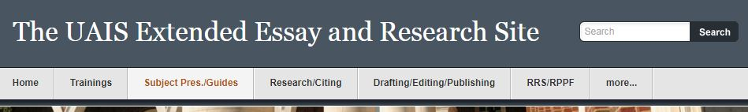
What’s next?
Go to uaisresearch.com website:
  Tab: Subject Pres./Guides
  Find and read 3 of your IB courses subject specific guides
  Note specific requirements

Slide 63
UAIS Process: Supervisor Selection
Students submit two EE proposals in two separate subjects; EE coordinator collects by November 6th
Full UAIS staff divides students according to teacher’s expertise in proposed areas and past practices and to balance staff responsibilities
Supervisor-student pairings announced on or before November 17th via Managebac
No shopping around for supervisors or trading!
  This is about you doing solid research and managing yourself! A supervisor does not impact this.

Slide 64
I have a supervisor, subject and potential topic, now what?
The Research Process Begins…
Sign up and see your supervisor between November 18-26th
Discuss with your supervisor:
  The location of materials for your topic
  A proper academic referencing system
  A general list of sub-headings for your paper
  A developing list of EE reading for background and information-gathering
  Internal UAIS deadlines
  Best times to meet or discuss the EE

Slide 65
Researching options to get you started:
Local municipal library
  Troy shares with Sterling Heights
College/University libraries
  Oakland University loves us!
MEL or Questia database
  UCS student email = username case sensitive
  Password= Its…
    If you created new password and forgot contact Questia and not me

Slide 66
Continue on…
Once students have read more deeply in their areas and assembled a stronger background from which to work, they will begin carrying out their investigation through proper researching techniques that are consistent, balanced, and organized. Failure to buy in to this process looks like this…

Slide 67
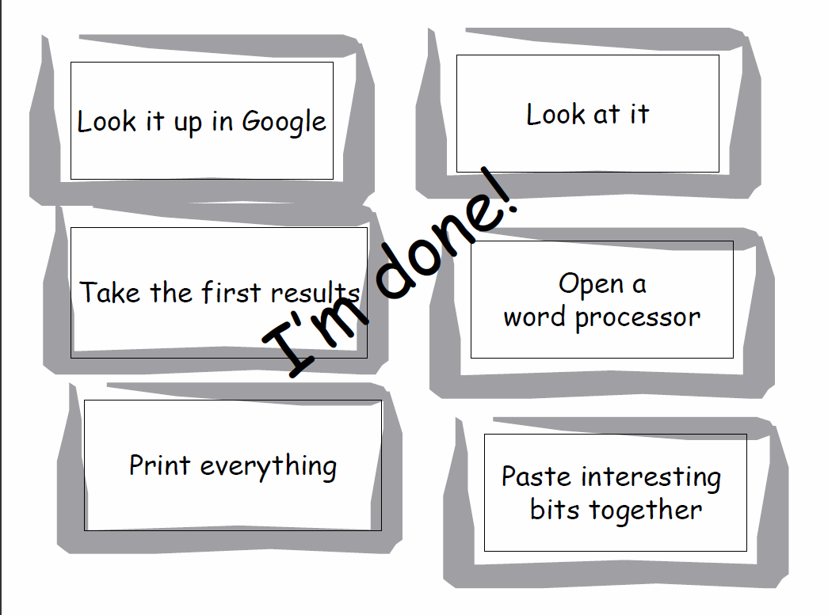
But I Looked It Up!

Slide 68
EE and DP Intervention
Students are required to be proactive in attending meetings, completing assignments, and communicating struggles
DP Intervention form submitted to Layson, Spear, Yeokum on all levels
Potential loss of group 2 or group 4 topic if missed lab or draft date
Will impact college application process

Slide 69
So, what about those results?
Grades are not often released worldwide by the IBO
The latest information shows us the following very interesting statistics, from which many inferences can be drawn…

Slide 70
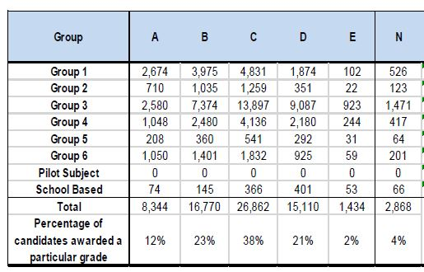
May 2015 World Statistics

Slide 71
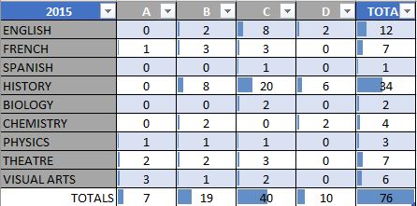
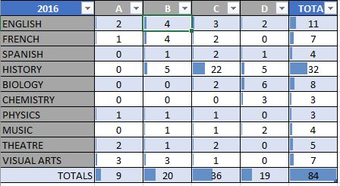
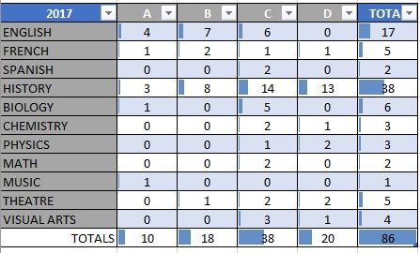
UAIS
2015 - 2017

Slide 72
FAQ:
Will your supervisor give you positive or negative feedback, or just suggest alternatives?
  All of the above
At the meetings will content be discussed?
  Yes
If we do Group 2, does our reflections have to be in that language too?
  Oui. Si. Hai.
Would you be able to get English credits for writing an EE in Group 2?
  Universities and colleges look at Writing/ Rhetoric/Composition – check with each place if it qualifies

Slide 73
CAS/EE Parent Contract
Discussed in early September at DP parent night
Required for parents to understand IB core requirements and policies
Specific requirements for group 2 and group 4

Slide 74
Review of Upcoming EE Calendar
Group 4 and Group 2 mandatory sit-down meetings by October 27th for those interested
Topics of Interest Due by Nov. 6th in the counseling office (box)
Supervisor Decisions: mid November
Supervisors Announced: Weekend of November 17th via Managebac
First Conference Window: opens week of Nov. 18th
Possible General Rubric Training session TBD
  Subject specific – ask supervisor

Slide 75
EE “Final” Question Proposal Form
Printable on the UAIS Research website
Step-by-step guide to formulating research question
Completed AFTER general topic is approved
Must be signed by each of you (approximately March) with your supervisor

Slide 76
Coordinator Communication
Coordinator announces reminders through UCS email and MB
Remainder of site used to guide the process, almost like an online class, via Managebac and UAISresearch.com
Specific questions addressed through supervisor
Any other questions ask me – I am your:
  Advocate
  Encourager
  Drill Sargent

Slide 77
Wrapping Up…
From this point forward, everything you need is on the EE website…
Once assigned to supervisor, work toward “EE ‘Final’ Question Proposal Form” for March (on EE website)
Use “Glossary of Terms” to help complete the Rough Draft Question
Be prepared to discuss some ideas for preliminary background reading (your supervisor will help, but don’t come empty-handed)

Slide 78
Advice to Students: DO…
Start early! Follow UAIS deadlines.
Think and plan carefully your proposal and your question
Share excerpts from your RRS with supervisor
Plan a schedule for yourself for completing EE
Choose collegiate level resources (i.e. Questia)
List every source on your bibliography as you go
Follow the rubric and final checklist UAIS provides

Slide 79
Advice to Students: Do NOT…
…forget to analyze/answer the question
…ignore the EE rubric
…waste time collecting data irrelevant to your question
…surf the Internet aimlessly, repeatedly, with no discipline
…show lack of discipline in citing sources
…cite sources that aren’t used in paper

Slide 80
Advice to Students: Do NOT…
…use Wikipedia, About, Yahoo, blogs, History.org, etc…
…avoid meetings or be absent to buy time
…ignore the checklists provided
…think you can put any of this off (procrastination is your worst enemy)
…cite only websites addresses – shame on you; I showed you better!
…copy/paste and cite – still considered unoriginal work and academic misconduct
…misquote, make stuff up, etc…academic miscondut
…forget you can do this! You had PT10!

Slide 81
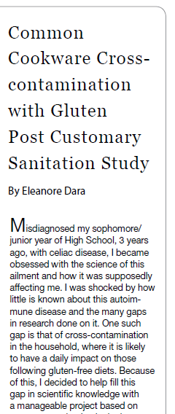

Did you know…?
Published research
College course opt-out
Instruct other college students
Enter into Honors College
*Anecdotal evidence supplied by former UAIS students-results may vary and are not a guarantee for all

Slide 82
IB Extended Essay Supports Success at U Va.
Key findings:
The IB’s extended essay does have an effect on student’s research confidence and willingness to engage in future research.
Former IB students felt strongly that the IB extended essay prepared them to conduct various facets of the research process.
When compared with former AP students, IB students were significantly more likely to indicate they:
  felt prepared for college-level coursework involving research.
  had in fact executed a research project at U Va. took pride in their research.
  intended to conduct future research.
  found their research skills to be important to their future success.
  felt supported, after completion of the extended essay, with skills such as gathering and evaluating evidence, and writing and time management, and that they experienced reduced anxiety around writing.
A statistically significant relationship existed between extended essay scores and first-semester and final semester college GPAs, after controlling for background characteristics.
Released: 1/30/2013 9:00 AM EST Embargo expired: 2/1/2013 12:00 PM EST
Source Newsroom: International Baccalaureate

